Slide 1

Identify root components of website below

Slide 2

Root div
- Height: 100vh
content
nav
Flex: 0
header
Flex: 0
Flex: 1

Slide 3
Flex: 0
content
nav
Flex: 1
Flex-direction: column

Slide 4

header
Flex: 1
main
Flex: 2

Slide 5
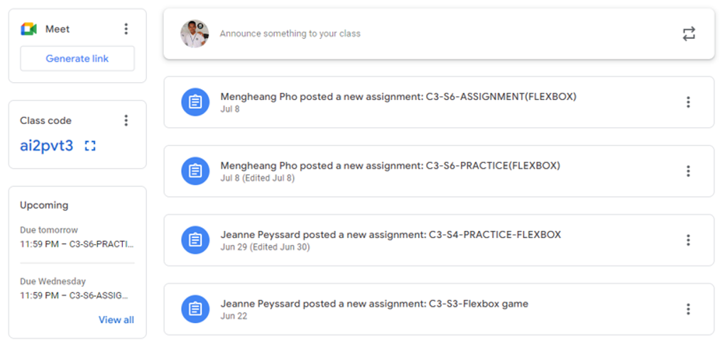
Sidebar
Main-content
Flex: 1
Flex: 2
Flex: 1
Flex: 2

Slide 6
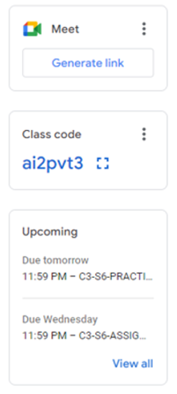
Pannel 1
Flex: 0
Pannel 2
Flex: 1
Flex: 0
Pannel 3
Flex: 1
Flex: 1
Flex-direction: column

Slide 7
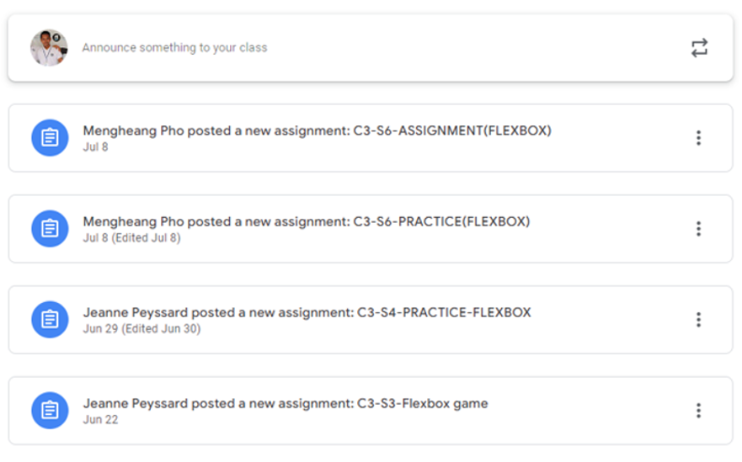
Announcement post
Content-1
Content-2
Flex: 0
Content-3
Content-4
Flex-direction: column

